Slide 1


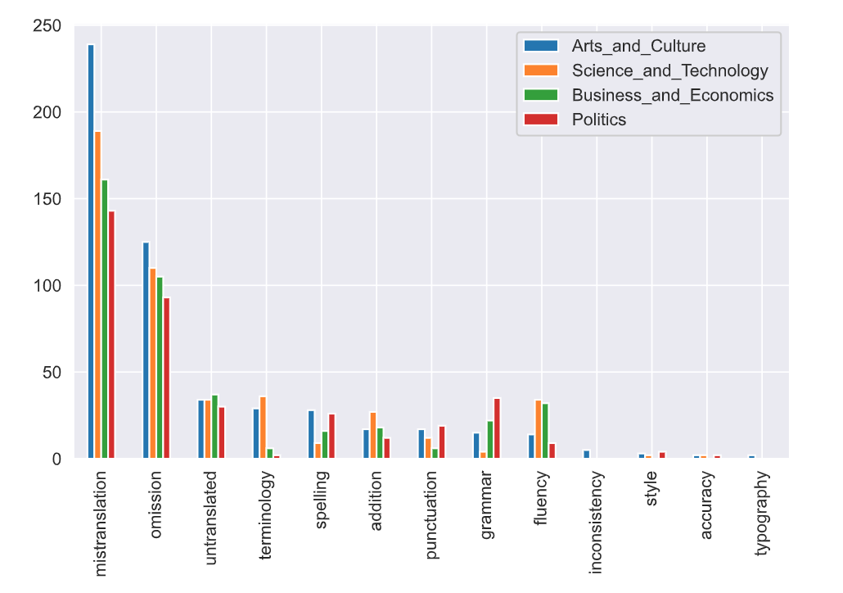


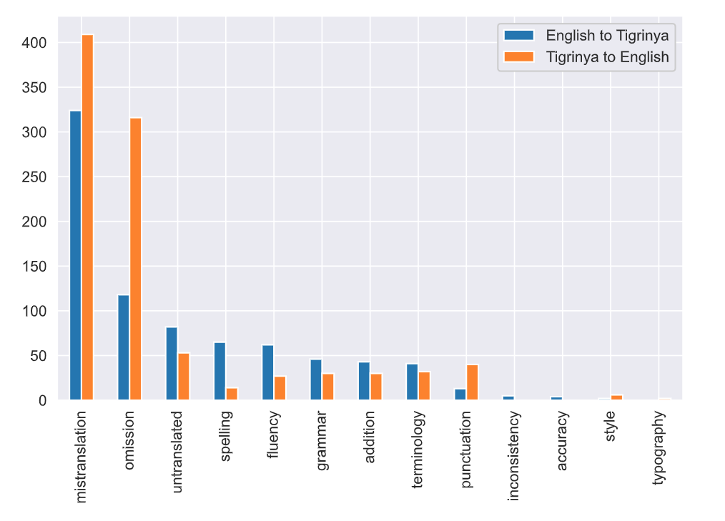
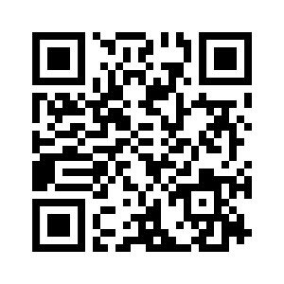
ERROR ANALYSIS OF TIGRINYA–ENGLISH MACHINE
TRANSLATION SYSTEMS
NEGASI HAILE* NUREDIN ALI ASMELASH TEKA*
negasihaile.abadi@gmail.com , ali00530@umn.edu , asme@lesan.ai
Introduction
Data Collection
Tigrinya is a low-resourced language that is spoken by more than 10 million native speakers mainly in Tigray, Ethiopia and Eritrea.
In recent years, we have seen some progress in the development and deployment of MT systems for a handful of African languages.
Evaluating the quality of such systems is fundamental to accelerating progress in Machine Translation systems.
In this work, we evaluated the current status of state-of-the-art MT systems that support the translation of Tigrinya to and from English: Google translate, Microsoft translator, and Lesan AI.
The data is gathered from 4 domains: Arts and Cultures, Science and Technology, Politics, and Business and Economics.
From diverse data sources including News sites, social media platforms, text books, Wikipedia articles.
The dataset contains 100 article snippets from each domains as well as direction.
In total 805 snippets (403 Tigrinya and 402 English).
Methodology
Fig 2. Distribution of error by domain. Arts and Culture followed by Science and Technology have a higher number of errors.
We used the Multidimensional Quality Metrics (MQM) and Dynamic Quality Framework (DQF) standard error typology.
Provides a common vocabulary for translation errors, and it was standard topology in MT evaluation.
MQM-DQF error categories: Accuracy, Fluency, Terminology, Style, Design, Locale Convention, Verity.
Two experts participated in the evaluation process. The annotators had 72% inter-reliability agreement on labeling the error types.
Findings
61.2% had translation quality issues.
Most common error types are Mistranslation and Omission with 66.2%.
The translation systems perform poorly when translating Tigrinya sources to English.
Arts and Culture is the most challenging followed by Science and Technology in current systems.
Main Contributions
Implications
Evaluate current state of Tigrinya-English Machine Translation Systems.
Quantify the most common translation issues present in current machine translation systems for Tigrinya to and from English.
Through a comprehensive analysis of their weaknesses, we provided practical suggestions for improvement.
Current Tigrinya MT systems perform relatively well on particular domains such as Politics, and Business and Economics.
Increasing domain diversity to the training sources.
Incorporating of abbreviations and named entities in to avoid code mixing.
Utilization of diverse data sources may aid in addressing issues with handling multiple dialects and styles.
Fig 2. Distribution of error by translation direction. The systems perform poorly when going from Tigrinya to English.

